Slide 1

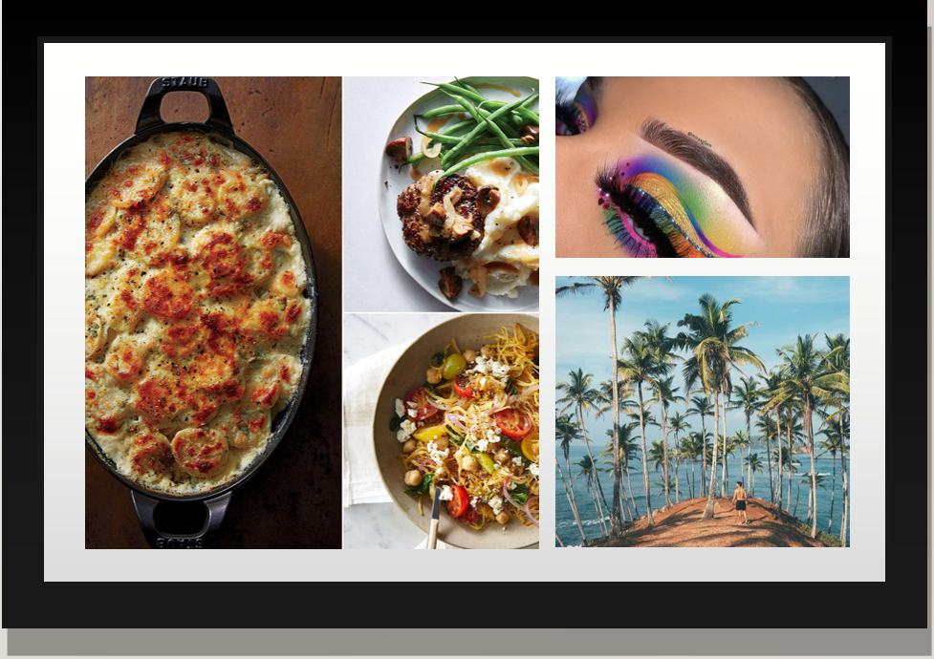
PINTEREST
"Find your inspiration"

Slide 2
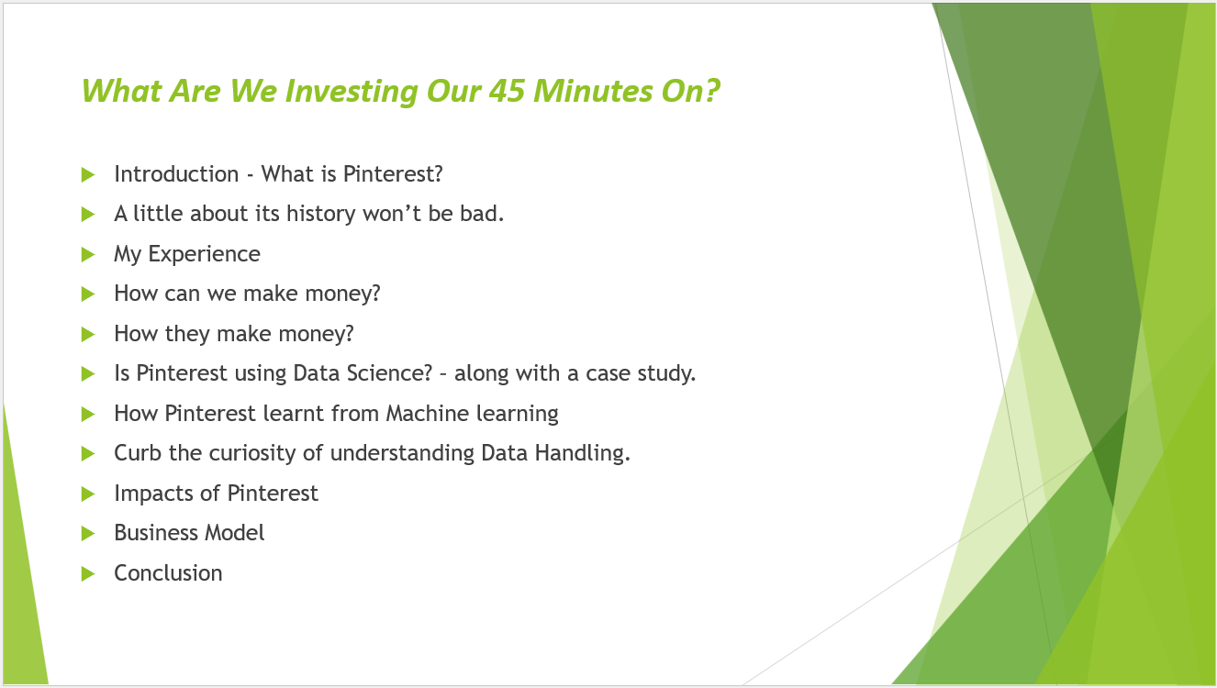
PINTEREST
"Find your inspiration"

Slide 3

Would You Like To Know If Pinterest’s a Human?
Pinterest is a social media platform that has been gaining immense popularity over the past few years.
The platform allows users to create, share, and discover content on a virtual bulletin board.
Quick Intro - https://www.youtube.com/watch?v=oJzD4vF5dFA

Slide 4
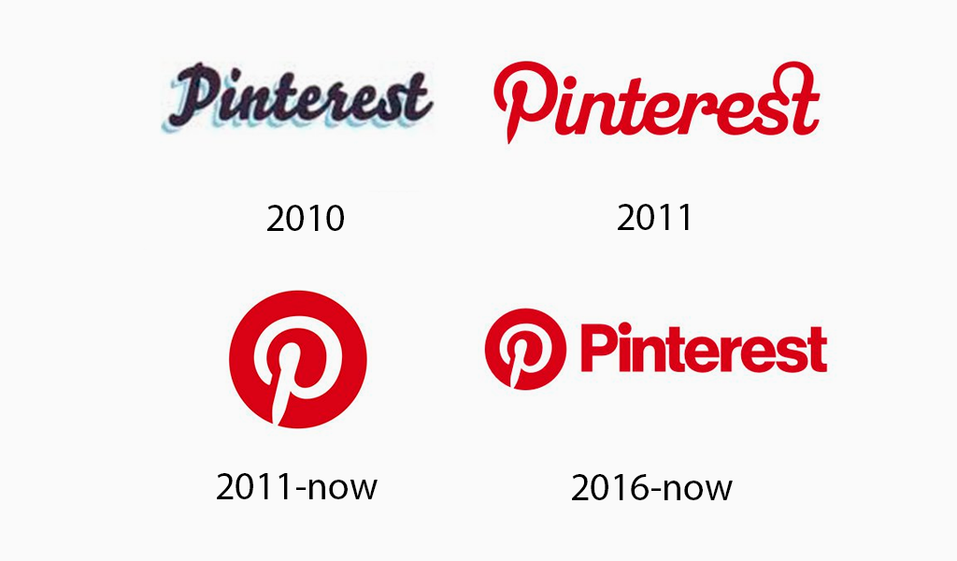
How it Evolved !!!
Pinterest was launched in March 2010 by Ben Silbermann, Paul Sciarra, and Evan Sharp.
In 2012, Pinterest reached a major milestone by surpassing 10 million users. The platform also started to attract attention from marketers, who saw the potential of the platform to reach a highly engaged audience.
In 2013, Pinterest introduced its first paid advertising product, which allowed businesses to promote their products and services on the platform.
Since then, Pinterest has continued to grow and has become one of the most popular social media platforms. As of January 2021, the platform had over 459 million monthly active users, with over 85% of users accessing the platform through mobile devices.

Slide 5
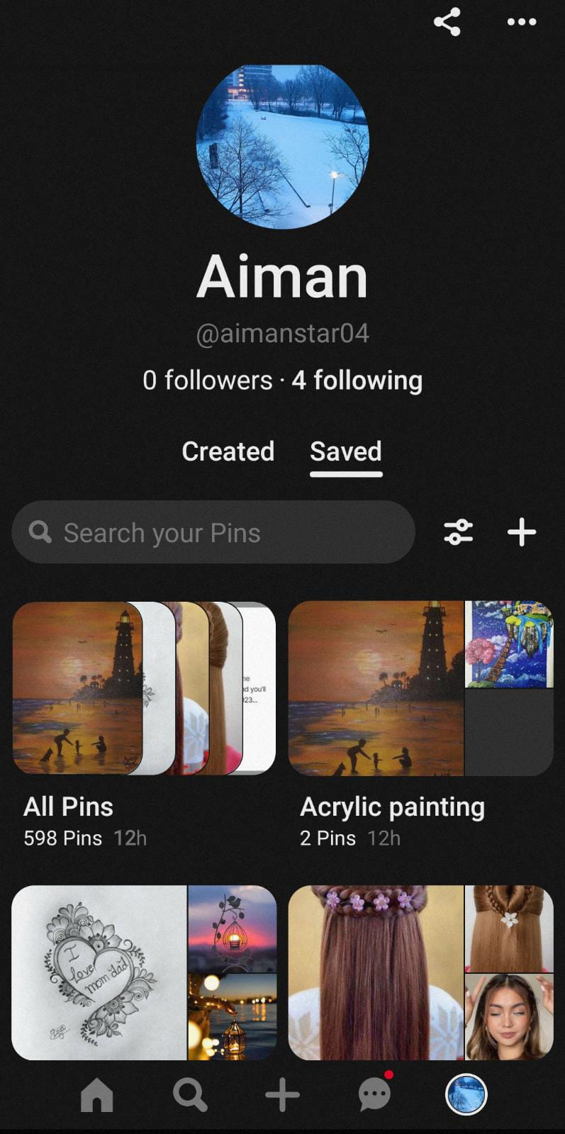
It Puts a Spell On me !!
Let’s have a live look on how to create and save a pin.
Let’s search for something and create a new board to save it.
Not all games are won - https://www.youtube.com/watch?v=_2tlO_ZCiQU

Slide 6
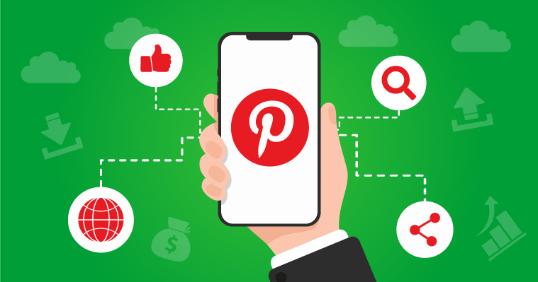
Do You Wanna Earn ?? - Business with Pinterest
Create a Business Account
Optimize your Profile
Create and Share High-Quality Content
Use Pinterest Ads
Engage with your Audience
Monitor Analytics
No Pocket Money – Sorry…!!

Slide 7
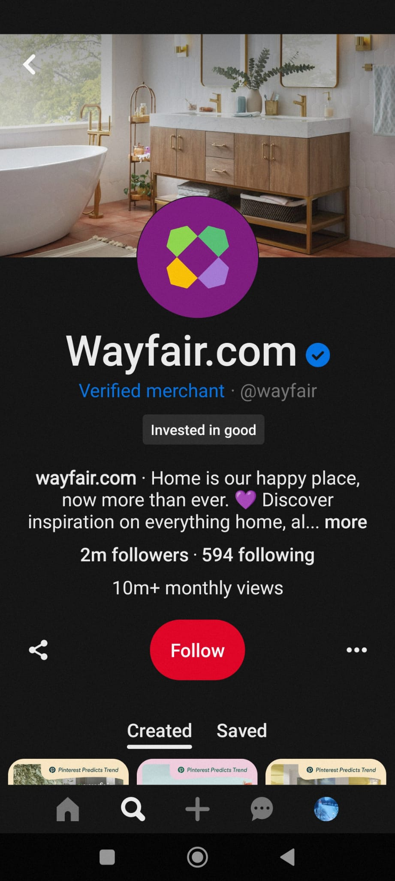
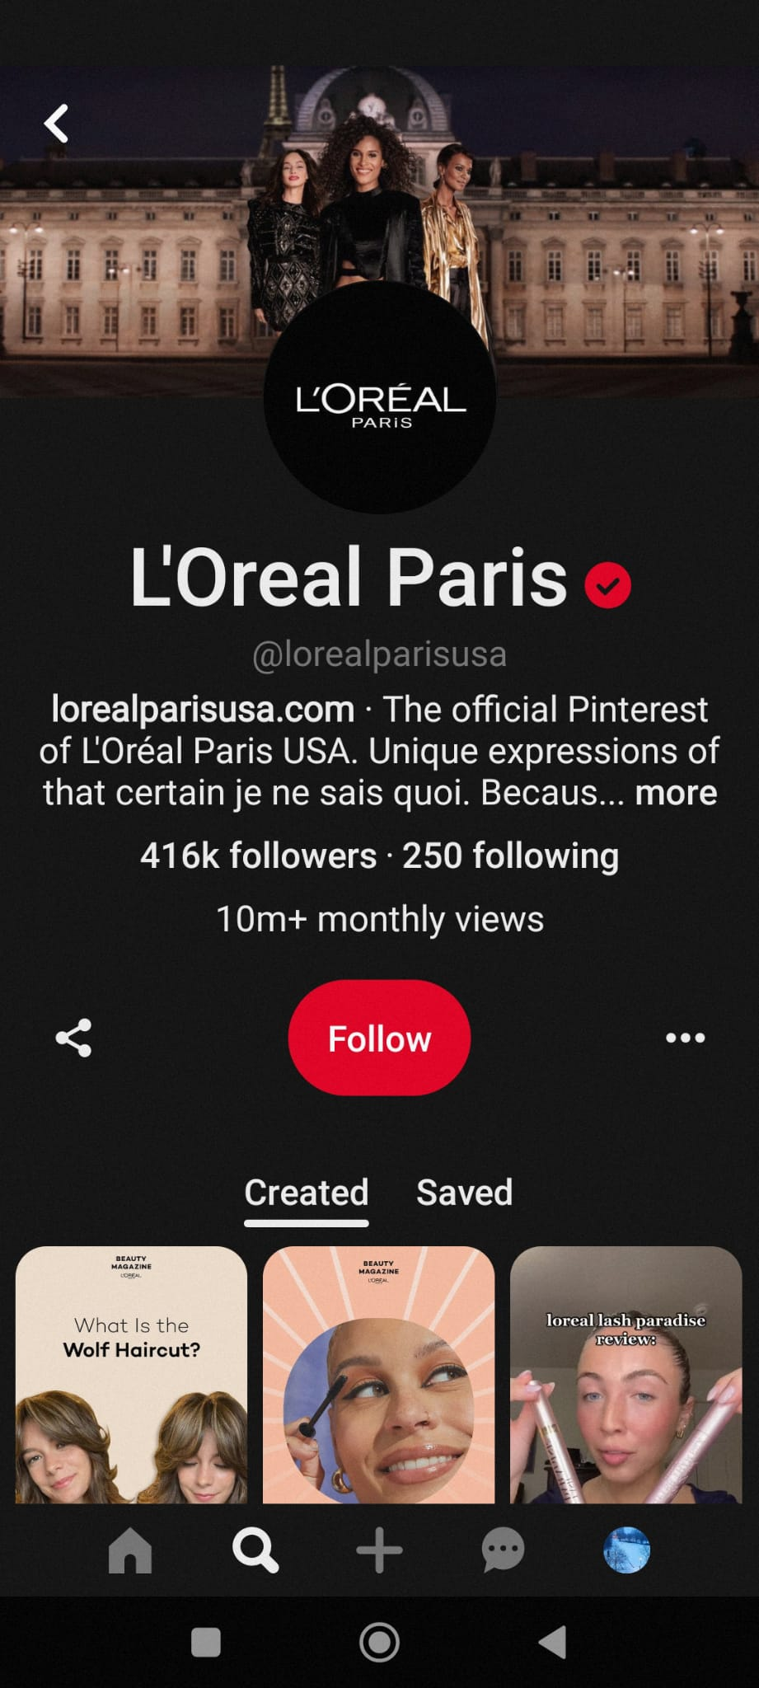
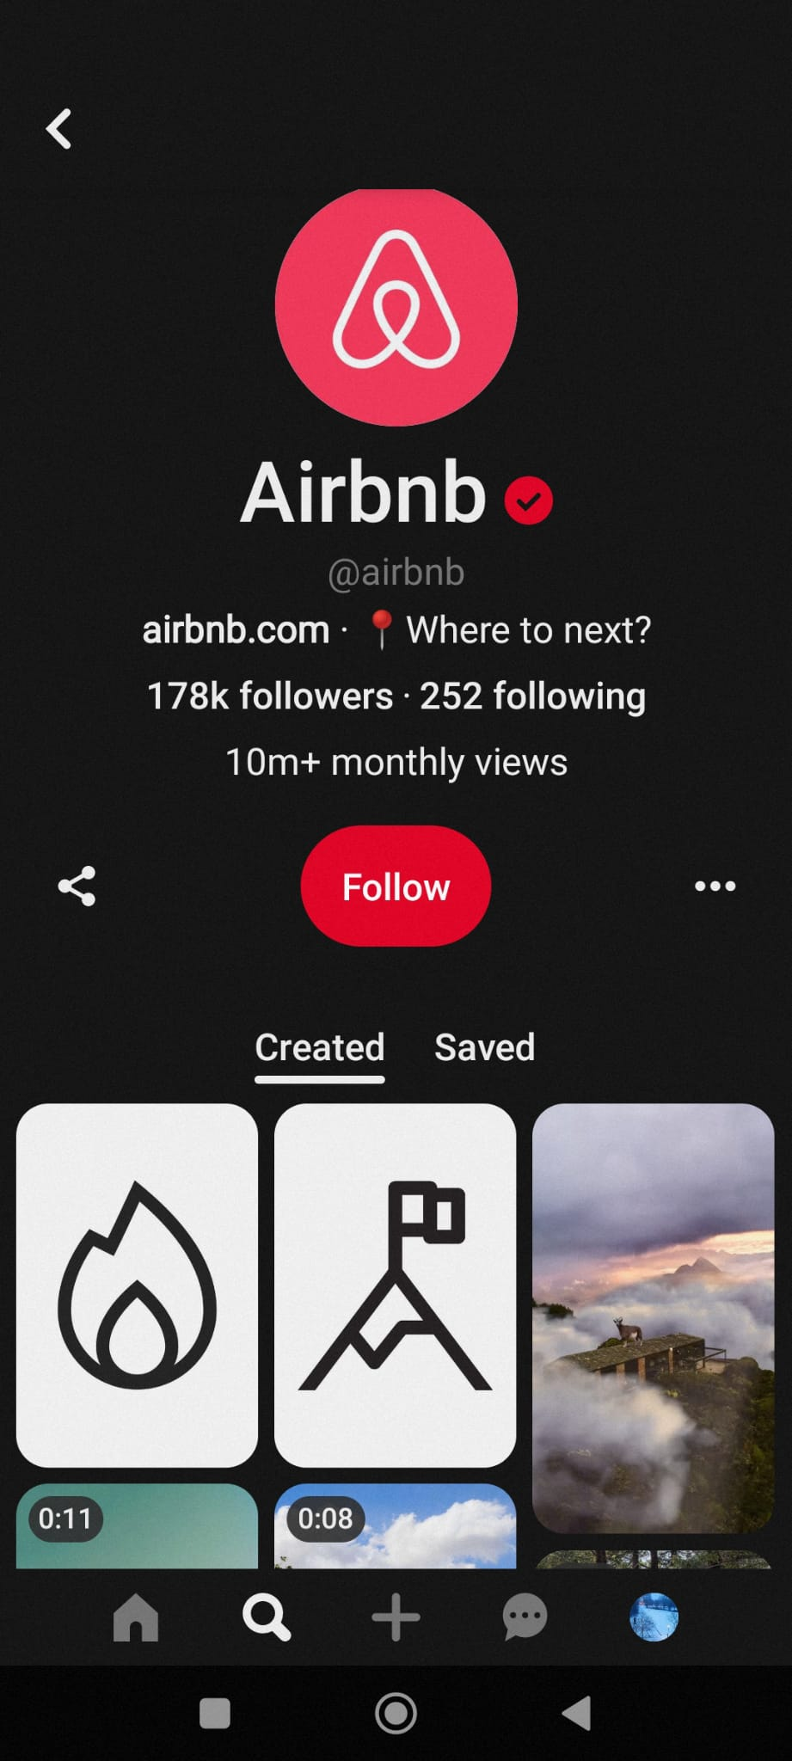
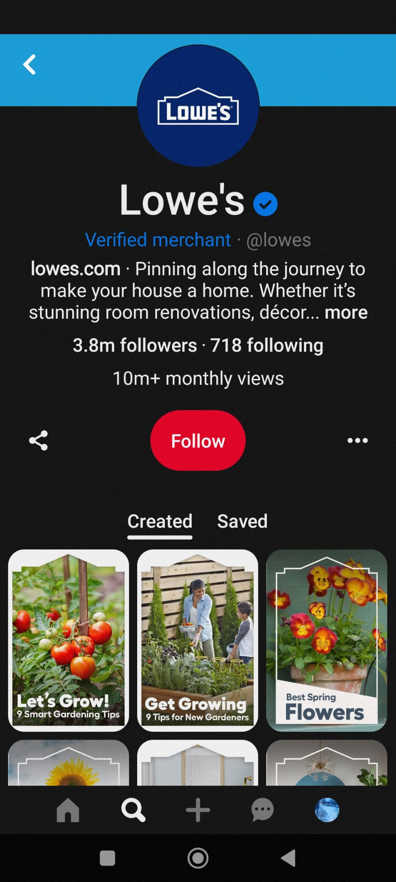
Some Popular Businesses that made significant Progress after Pinterest was Born

Slide 8
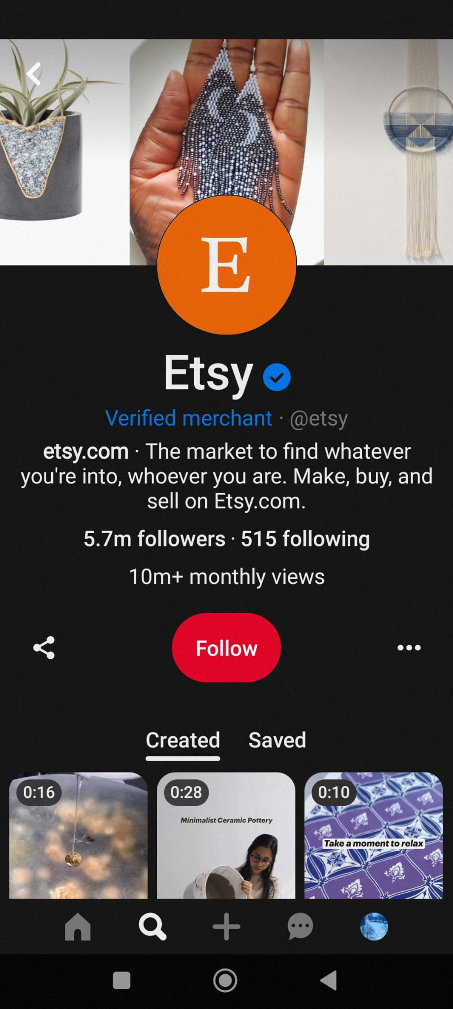
Has common people benefitted as well?
Etsy - handmade and vintage items
Challenge: Etsy needed a way to reach new customers and drive sales without spending a lot of money on advertising.
Solution: visually appealing products at Pinterest
Results: Referral traffic -increased by 107% year-over-year and revenue increased by 4x.

Slide 9

Well They Make Some Money Too …
Lets hear from them - https://www.youtube.com/watch?v=N1Gr2DQtpSc
Promoted Pins
Promoted Video Pins
Promoted App Pins
Pinterest Shopping
Pinterest Partnerships

Slide 10
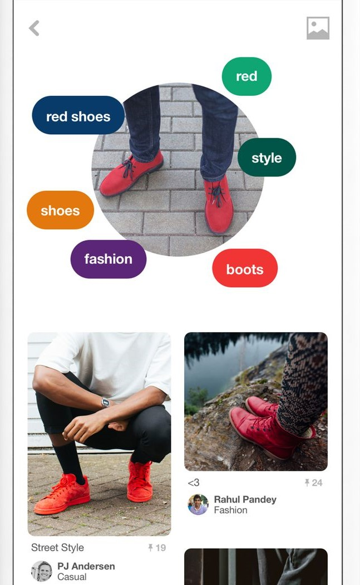
Is Pinterest using Data Science ?
Recommender Systems: Pinterest uses recommender systems to suggest pins and boards to users based on their interests, behaviors, and preferences.
Search Ranking: Pinterest uses machine learning and natural language processing to improve search ranking and relevance
Ad Targeting: Pinterest uses data science to target ads to users based on their interests and behaviors.
Content Moderation: Pinterest uses machine learning to moderate content and prevent spam, scams, and inappropriate content.
Trend Identification: Pinterest uses data science to identify and analyze trends in user behavior and content.

Slide 11
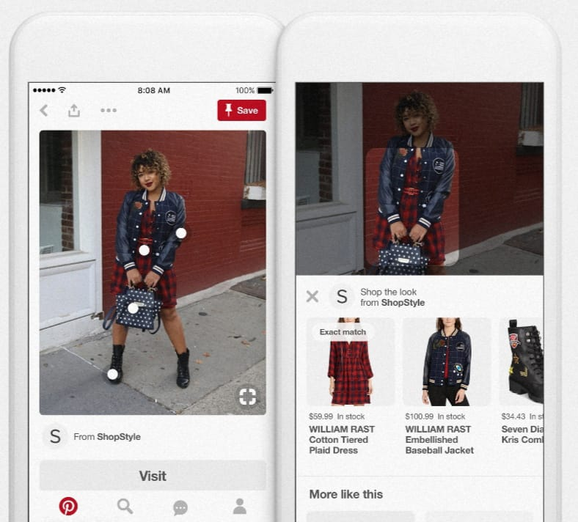
Roads to Success aren’t easy.. Business Challenge Case Study
Business Challenge: attract more users and advertisers.
Business Strategy: user growth, engagement, and monetization.
Solution - "Pinterest Lens" (which allows users to search for items by taking a photo) and expanding its ad offerings.
Results - 47% year-over-year increase and 93 million new users in 2021.
Notes:
11

Slide 12

Pinterest with ML- The Discovery Problem
Pinterest had to disentangle the “discovery” problem, understand what people are looking for from the three or less words they input in the search bar.
Pinterest need to “build technology to not only keep up, but make recommendations smarter”
Therefore, it developed PinSage, a neural network placing each image, according to a specific theme, within a graph of other images.
Thereafter, people started to receive a more personalized recommendations.

Slide 13
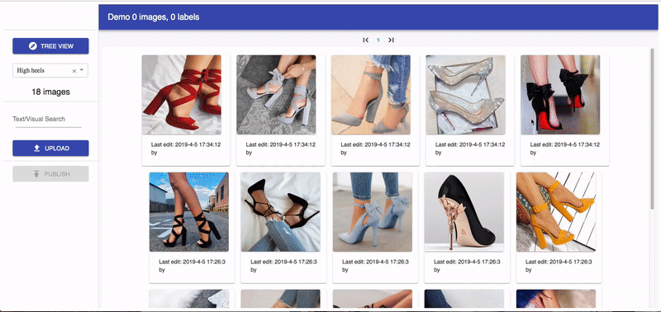
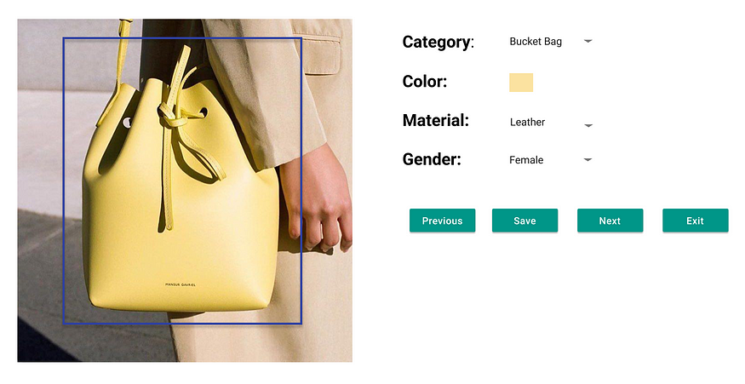
Voyager – The one who take Pinterest Further Building A scalable data management system for computer vision tasks
Pinterest designed a centralized, scalable, and flexible data management tool called Voyager.
Voyager supports dynamic taxonomy management, which mimics that of a file system.
Users can manage their data similar to how they manage files and folders on laptops.
Building A scalable data management system for computer vision tasks | by Pinterest Engineering | Pinterest Engineering Blog | Medium
Notes:
13

Slide 14
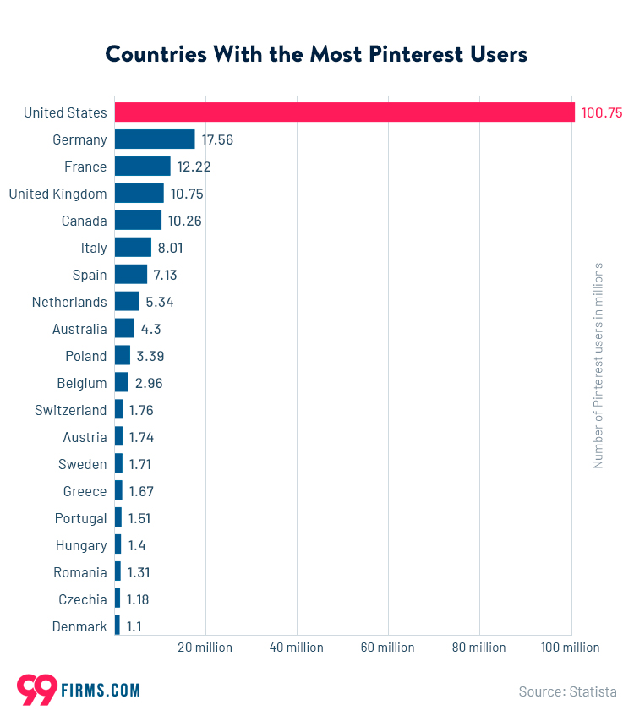
Many are Jealous….
Ability to drive traffic to websites.
Influence purchase decisions.
Content creators and influencers to reach a highly engaged audience.
Surveys
by Omnicore in 2020, 85% of Pinterest users reported that they use the platform to plan for life moments and events, such as weddings, home renovations, and travel.
A survey conducted by Pinterest in 2021 found that 89% of users said that Pinterest is a positive place, and 91% said that they use the platform to feel inspired.
In a survey conducted by Social Media Examiner in 2021, 25% of marketers said that they use Pinterest for advertising, and 82% of those who use Pinterest for advertising reported that it was effective for driving website traffic.
Notes:
14

Slide 15
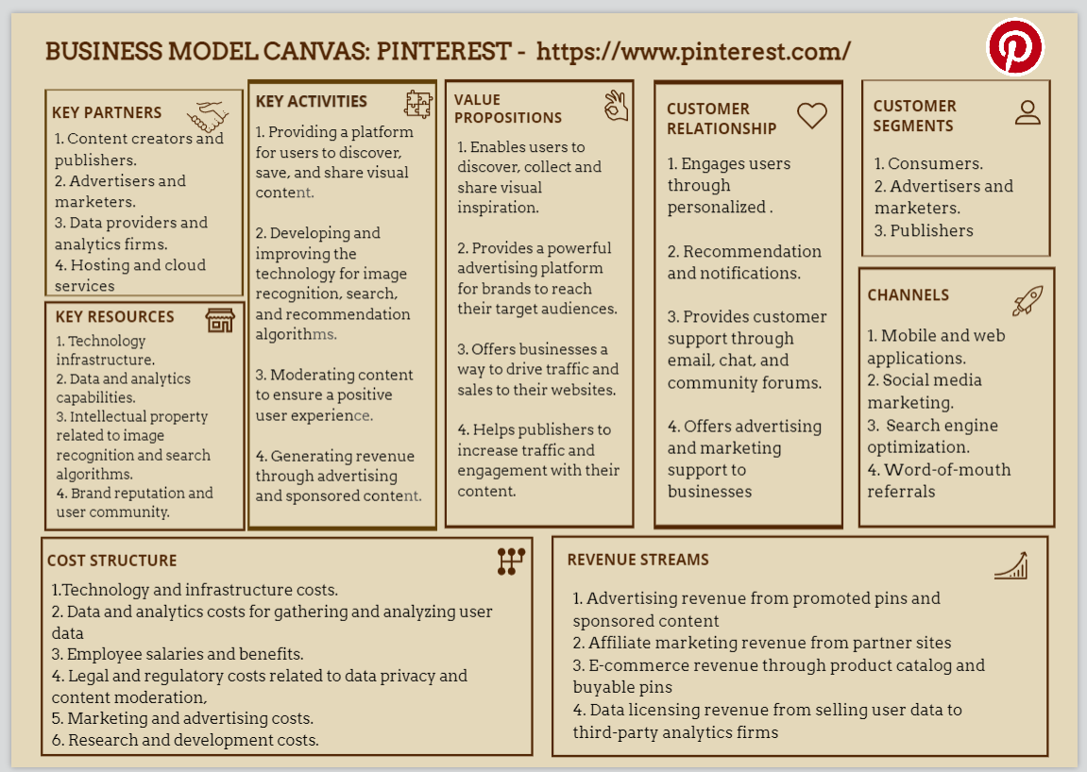
Business Model

Slide 16
Conclusion – Let’s Relax
https://www.youtube.com/watch?v=-jFFsBapBhA
Don’t Don’t Yourself, no matter what your Internet Induced Anxiety says. Nothing silences our saboteurs like the simple act of doing.
So take a break from the headlines and find your next relaxation idea on
Pinterest and breathe.

Slide 17


Slide 18
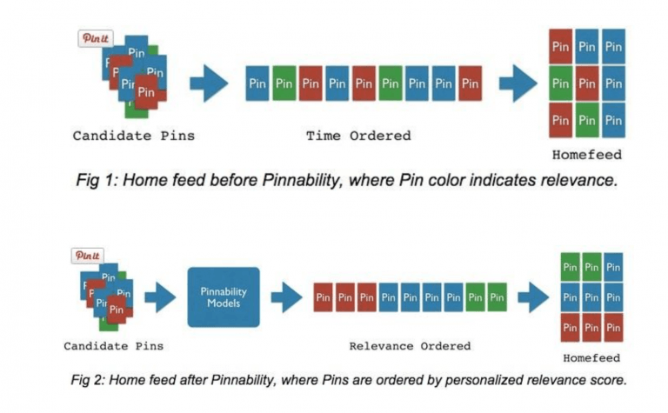
Machine learning in the home feed through Pinnability
The growing number of saved items posed another crucial challenge: how does pinterest surface the most personalized and relevant pins?
Pinterest developed Pinnability, a collection of machine learning models.
Pinnability “estimates the relevance score of how likely a pinner will interact with a pin” and it allows accurate predictions, through which the pinterest team prioritizes pins based on a relevance score. Therefore, pins are not showed anymore in a chronological order as it used to be rather in Relevance Order.
Notes:
18

